Slide 1
What is electronic Central Booking ?
The integration of livescan fingerprinting, automated fingerprint identification, digital photography, video conferencing and computerized databases. By utilizing these technologies, the whole arrest process can be completed more efficiently and accurately. The integration of the devices also allows background information to be returned to the booking center within minutes while the subject is in custody. And with adequate staffing employed to operate the equipment, officers are able to return to patrol more rapidly.

Slide 2
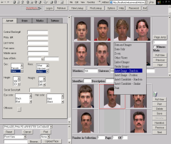
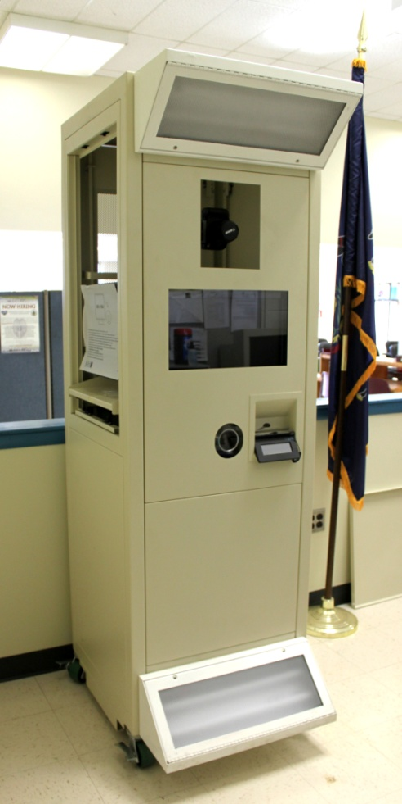
Central Booking includes CPIN (Commonwealth Photo Imaging Network)
9’ x 12’ room required

Slide 3
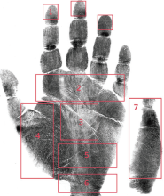
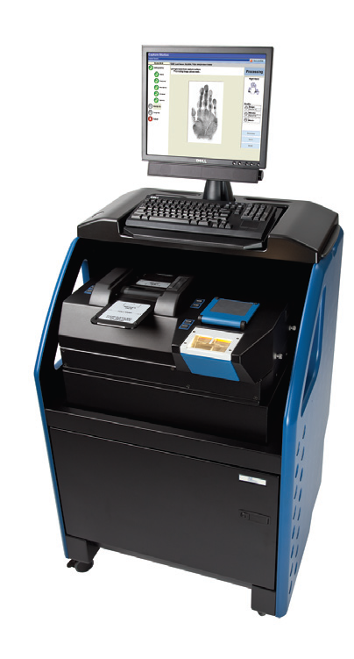
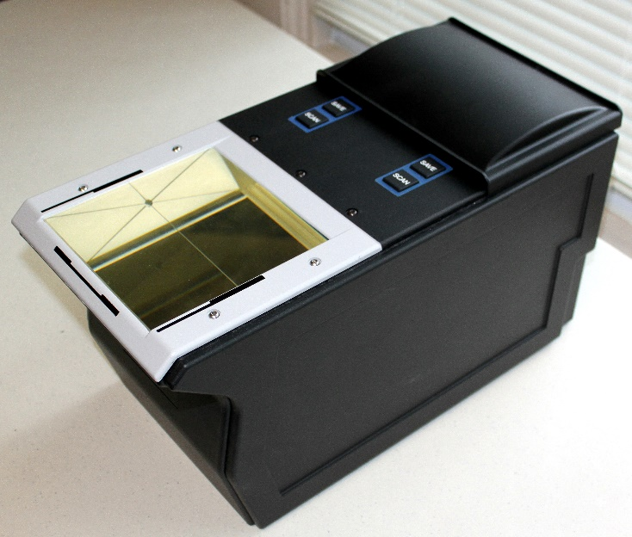
Central Booking includes Livescan fingerprinting

Slide 4
Central Booking includes a CLEAN terminal & data circuit, fax & phone lines

Slide 5
Central Booking includes Video Arraignment utilizing video conferencing technology connected over IP, internet

Slide 6
Central Booking in Pennsylvania
The central booking concept throughout Pennsylvania employs a wide variety of implementations, from the single agency that books only for themselves, to the full countywide agency that processes for the entire law enforcement community in a county.
Staffing varies from employing full time booking agents to requiring an arresting officer to do the processing himself.
Locations range from local police departments, county sheriffs offices, probation and parole offices, prisons, district attorney offices, and state police barracks.

Slide 7
Key Benefits
Within minutes the program will:
Verify arrested persons past criminal history through fingerprinting
Add current arrest information
Capture and record finger and palm print, facial images, scars, marks, tattoos, etc.
electronically transmits all data to PSP central repositories, Web CPIN, AFIS, CCHRI, Facial Recognition System, FBI
Present all information to the District Justice for preliminary arraignment while the arrestee is being held
Allows the officer to immediately return to patrolling his community

Slide 8
Additional Benefits
increase public safety and productivity by verifying suspects identity and returning officers to patrol
running records against state and federal databases for increased homeland security
saves money on offender transportation
saves money on booking staff salaries – officer pay vs. civilian employee
saves time spent waiting for preliminary arraignment

Slide 9
Administration
To function properly:
must be a cooperative effort between law enforcement, prosecutors, district justices, county, and local officials
personnel must be properly trained in the operation of the equipment and the importance of making every effort to take the highest quality of both biometric and demographic data from the person being booked
employ a full time manager
employ dedicated booking agents
good geographic location to enable easy access by all participating agencies
easy ingress and egress of the booking facility itself to allow for quick prisoner drop off
security of the facility

Slide 10
Administration continued…
public access for walk-in processing and Megan's Law fingerprinting, if designated to do so by the county
adequate holding cells and separate cells for male, female, and juveniles
adequate funding plan for personnel, equipment purchases, maintenance contracts, and supplies
inclusion in a countywide central booking plan to permit the collection of the processing fees allowed by PA Act 81 (can be up to $300 per person convicted of most criminal offenses)
should not charge a fee to participating agencies
policies and procedures for the booking steps as well as officer, booking agent, and all personnel safety

Slide 11
CLEAN Certification Requirements
Personnel using the livescan at the Booking Center will need a CLEAN account to access the results via the CLEAN terminal when they livescan a person.
Booking center personnel have limited access to CLEAN.
They must pass a fingerprint background check and be without significant convictions.
Each agency will need to appoint a TAC officer (Terminal Agency Coordinator) who is the liaison between their agency and CLEAN.
PSP CLEAN Admin holds 2 CLEAN trainings a year for Basic Operators which helps them to maneuver through the CLEAN Portal. If they can’t attend any of the CLEAN trainings the TAC helps them. Usually someone is hired at the Booking Center with CLEAN Experience. CLEAN Admin is also available to assist them.

Slide 12
Total full booking systems in PA = 183
ERIE
WARREN
McKEAN
TIOGA
BRADFORD
SUSQUEHANNA
CRAWFORD
POTTER
WAYNE
FOREST
WYOMING
VENANGO
ELK
CAMERON
SULLIVAN
LACKAWANNA
MERCER
LYCOMING
PIKE
JEFFERSON
CLINTON
CLARION
LUZERNE
476
LAWRENCE
CLEARFIELD
COLUMBIA
MONROE
UNION
MONTOUR
BUTLER
ARMSTRONG
CENTRE
CARBON
SNYDER
NORTHAMPTON
BEAVER
NORTHUMERLAND
INDIANA
MIFFLIN
SCHUYLKILL
CAMBRIA
JUNIATA
DAUPHIN
LEHIGH
ALLEGHENY
BLAIR
BERKS
99
PERRY
BUCKS
HUNTINGDON
LEBANON
WASHINGTON
WESTMORELAND
MONTGOMERY
CUMBERLAND
LANCASTER
CHESTER
PHILADELPHIA
FAYETTE
SOMERSET
BEDFORD
FULTON
YORK
DELAWARE
GREENE
FRANKLIN
ADAMS
Has at least one full hand Livescan & CPIN booking system (Act 81 compliant)
Does not have full booking system or no equipment at all
Has an Act 81 approved countywide central booking plan (48)

Slide 13
How can we help you?
PCPA has a dedicated team that will assist in every step of the process as well as help determine funding requirements for equipment and training needs. Through the power of the number of PCPA members, volume price discount agreements have been secured with vendors who supply much of the equipment needed in a booking center. Discounted maintenance contract pricing has been obtained on the livescan, CPIN equipment and AFIS remote terminals.

Slide 14
Contact Information
Jerry Miller, Offender Identification Technology Coordinator, at: jmiller@pachiefs.org or contact Christopher Braun, Technology Coordinator, at: cjbraun@pachiefs.org or PCPA Headquarters at 717-236-1059

Slide 15
Questions?

